Slide 1


Slide 2




Slide 3



TREES
AND
TERMINOLOGY

Slide 4
TREE
Tree is a non-linear data structure which organizes data in hierarchical structure and this is a recursive definition
Tree data structure is a collection of data (Node) which is organized in hierarchical structure recursively
A tree is a connected graph without any circuits
If in a graph, there is one and only one path between every pair of vertices, then the graph is called as tree

Slide 5
PROPERTIES
There is one and only one path between every pair of vertices in a tree
A tree with n vertices has exactly (n-1) edges
A graph is a tree if and only if it is minimally connected
Any connected graph with n vertices and (n-1) edges is a tree

Slide 6
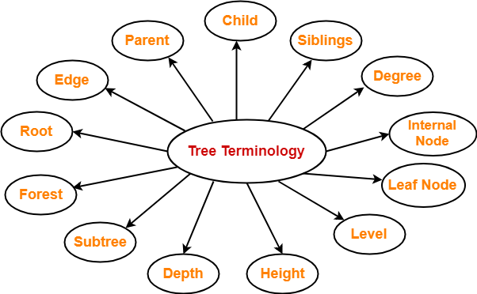
TREE TERMINOLOGY
Notes:
9080763830

Slide 7
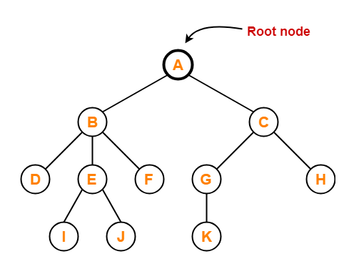
ROOT
The first node from where the tree originates is called as a root node
In any tree, there must be only one root node
We can never have multiple root nodes in a tree data structure

Slide 8
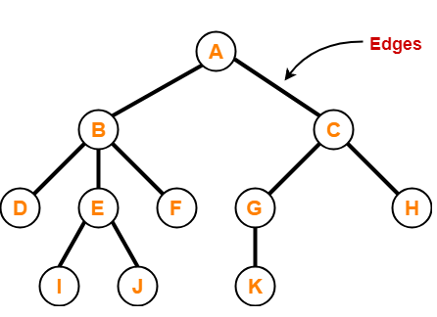
EDGE
The connecting link between any two nodes is called as an edge
In a tree with n number of nodes, there are exactly (n-1) number of edges

Slide 9
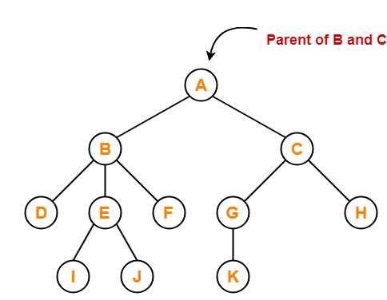
PARENT
The node which has a branch from it to any other node is called as a parent node
In other words, the node which has one or more children is called as a parent node
In a tree, a parent node can have any number of child nodes

Slide 10
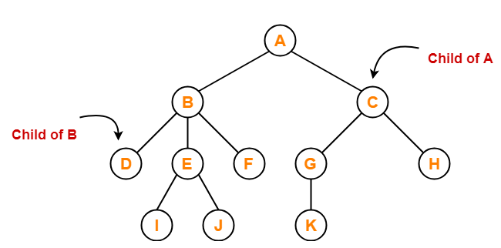
CHILD
The node which is a descendant of some node is called as a child node
All the nodes except root node are child nodes

Slide 11
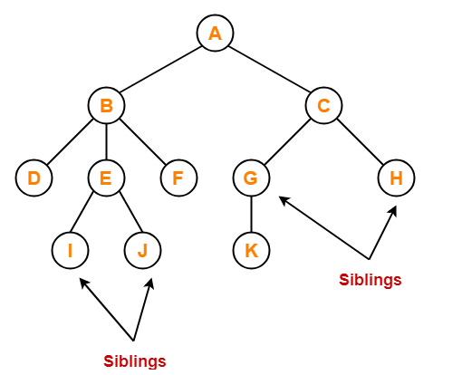
SIBLINGS
Nodes which belong to the same parent are called as siblings
In other words, nodes with the same parent are sibling nodes

Slide 12
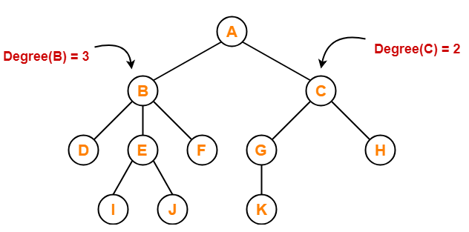
DEGREE
Degree of a node is the total number of children of that node
Degree of a tree is the highest degree of a node among all the nodes in the tree

Slide 13
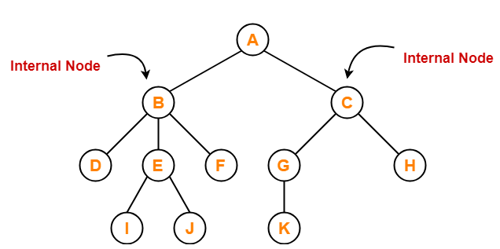
INTERNAL NODE
The node which has at least one child is called as an internal node
Internal nodes are also called as non-terminal nodes
Every non-leaf node is an internal node

Slide 14
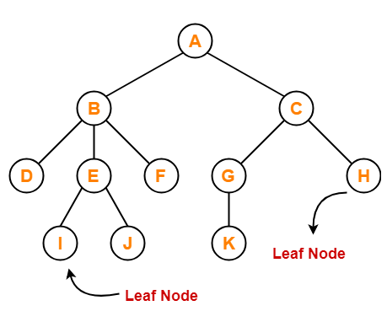
LEAF NODE
The node which does not have any child is called as a leaf node
Leaf nodes are also called as external nodes or terminal nodes

Slide 15
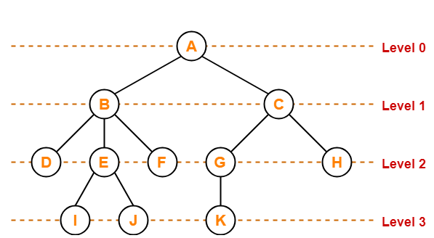
LEVEL
In a tree, each step from top to bottom is called as level of a tree
The level count starts with 0 and increments by 1 at each level or step

Slide 16
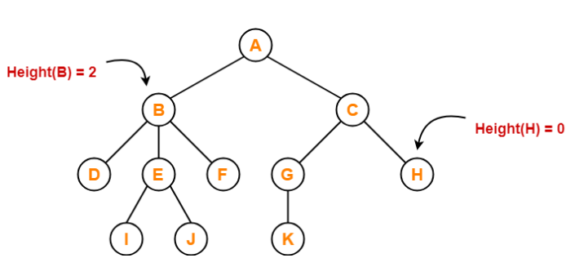
HEIGHT
Total number of edges that lies on the longest path from any leaf node to a particular
Node is called as height of that node
Height of a tree is the height of root node
Height of all leaf nodes = 0

Slide 17

DEPTH
Total number of edges from root node to a particular node is called as depth
Depth of a tree is the total number of edges from root node to a leaf node in the
longest path
Depth of the root node = 0
The terms “level” and “depth” are used interchangeably

Slide 18
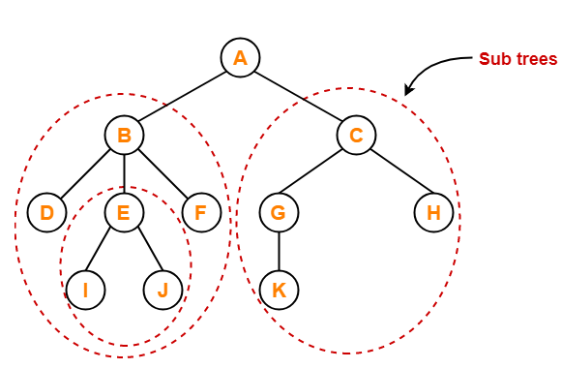
SUBTREE
In a tree, each child from a node forms a subtree recursively
Every child node forms a subtree on its parent node

Slide 19
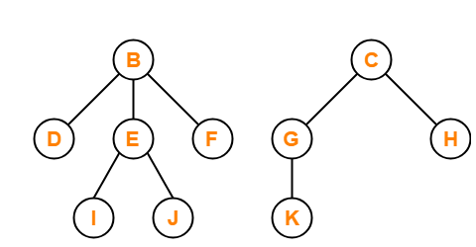
FOREST
A forest is a set of disjoint trees

Slide 20
QUESTION
Which of the following statements is false ?
Every tree is a bipartite graph
A tree contains a cycle
A tree with n nodes contains n-1 edges
A tree is a connected graph
Answer: B

Slide 21
QUESTION
Which of the following remarks about Tree- indexing are true?
It is an m-ary tree
Successful searches should terminate in leaf nodes
Unsuccessful searches may terminate in leaf nodes level of the tree structure
All of these
Answer: D

Slide 22
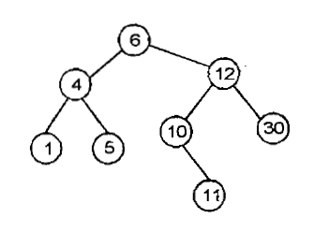
QUESTION
If this tree is used for sorting, then new no 8 should be placed as the
left child of the node labelled 30
right child of the node labelled 5
right child of the node labelled 30
left child of the node labelled 10
Answer: D

Slide 23
QUESTION
If each node in a tree has value greater the every value in its left subtree and has value less than every value in its right subtree, the tree is called
Complete tree
Full binary tree
Binary search tree
AVL tree
Answer: C

Slide 24

THANK YOU

